Slide 1
Staggered differences-in-differences and two-way fixed effects Applications for perinatal epidemiology
Dana Goin and Corinne Riddell
SPER Methods Workshop
Notes:
Hello and thanks so much for having me.
Today I will be talking about how we can use differences-in-differences to estimate the effects of interventions that are adopted in different places at different times, highlight some challenges and pitfalls of different analytic methods, and conclude with some takeaways for implementing these methods in your research.

Slide 2
Overview
Two-time point differences-in-differences
Staggered differences-in-differences
Two-way fixed effects
Alternate methods
Comparison of approaches
Simulations
Empirical example
Takeaways for your research

Slide 3

Differences-in-differences
Used to estimate the effects of
Policies
Natural experiments
Estimate the ATT
$\text{Treated}\text{(}\text{post}\text{ − }\text{pre}\text{) – }\text{Control}\text{(}\text{post}\text{−}\text{pre}\text{)}$
Notes:
To start, let me give a quick background on the differences in differences method, which is a common approach for estimating the effects of interventions, policies, or natural experiments in observational data.
The goal is to estimate the average treatment effect on the treated

Slide 4

Differences-in-differences
Estimate the ATT
$\text{Treated}\text{(}\text{post}\text{ − }\text{pre}\text{) – }\text{Control}\text{(}\text{post}\text{−}\text{pre}\text{)}$
0.02 – 0.01 = 0.01
0.12 – 0.10 = 0.02
0.09 – 0.08 = 0.01
Notes:
The idea behind the method is to take the difference in the outcome pre- and post-intervention among both the treated and control groups, and then take the difference of those differences.
Here is the classic example. We have two time periods, a pre-treatment and a post-treatment time. We have two treatment groups, the treated and control. In this example, our outcome is the risk of preterm birth.
The difference before and after treatment in our treated group is 0.02
The difference before and after the treatment happened in our control group is 0.01
Therefore, the differences in differences estimate is 0.02 minus 0.01 for an ATT of 0.01.
This approach allows us to calculate differences before an after an intervention or treatment, while accounting for any secular trends in the control group.
If a number of assumptions are met, gives an estimate of the ATT
We do have to assume parallel trends, which means the treated and control groups experience the same secular trends so that the difference between the pre and post treatment in the control is a good estimate of the difference we would have observed in the treated group in the absence of treatment

Slide 5

Differences-in-differences
Estimated using linear regression
$E(Y)=β_{0}+β_{1}I[treated]+β_{2}I[post]+β_{3}I\left[treated\right]I[post]$
$ATT=\left(Y_{1,1}−Y_{1,0}\right)−{(Y}_{0,1}−Y_{0,0})$
$Y_{1,1}=β_{0}+β_{1}+β_{2}+β_{3}$
$Y_{1,0}= β_{0}+β_{1}$
$Y_{0,1}= β_{0}+β_{2}$
$Y_{0,0}=β_{0}$
$ATT=\left(Y_{1,1}−Y_{1,0}\right)−{(Y}_{0,1}−Y_{0,0})=(β_{0}+β_{1}+β_{2}+β_{3} −β_{0}−β_{1}) −(β_{0}+β_{2}−β_{0}) =β_{3}$
Notes:
Often, DID is estimated using a linear model, with indicators for the treatment group, the post-intervention time, and then an interaction between the treatment and post-intervention indicators.
If the trend in the control units replicates what we would’ve seen in the treated units had they not been treated, then the beta-3 coefficient, which is the coefficient on the interaction of the treatment indicator and an indicator for post-treatment, gives us an estimate of the ATT
You can see here that if we plug in the linear model for each of the potential outcomes, the beta-3
coefficient on the interaction term is the DID parameter and the estimate of the ATT that we want

Slide 6
Staggered differences-in-differences
But… what if interventions are introduced in different places at different times?
Notes:
But what happens when interventions are introduced in different places at different times?
For example, maybe you are conducting a stepped wedge trial, or you are evaluating a policy that was adopted at different times in different states, or in different cities or counties (i.e. effects of Covid lockdowns).
In this example, we have 5 time points, two treated units, and one control unit. One of the treated units received the treatment at time point 2, while the other received the treatment at time point 4.

Slide 7
Staggered differences-in-differences
But… what if interventions are introduced in different places at different times?
Notes:
We can’t use the standard difference-in-difference approach here, because the post-treatment indicator variable is not well-defined for control units.
You can see here that when there are multiple treatment times, there are multiple options for when control units could be considered in the post-treatment time.
For instance, is the control unit in the “post-treatment time” starting at time period 2, or after time period 4? It depends on which treated unit you are comparing it to.

Slide 8
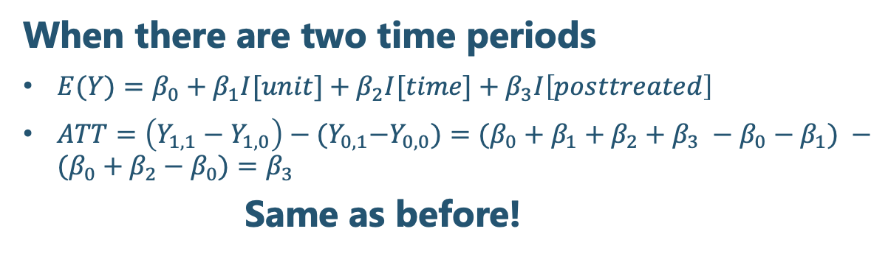
Implementation of two-way fixed effects
The standard approach
Unit fixed effects
+
Time fixed effects
+
Post-treatment indicator
When there are two time periods
$E(Y)=β_{0}+β_{1}I[unit]+β_{2}I[time]+β_{3}I\left[posttreated\right]$
$ATT=\left(Y_{1,1}−Y_{1,0}\right)−{(Y}_{0,1}−Y_{0,0})=(β_{0}+β_{1}+β_{2}+β_{3} −β_{0}−β_{1}) −(β_{0}+β_{2}−β_{0})=β_{3}$
Same as before!
But… what if interventions are staggered across time?
Notes:
In this case, the standard approach has been to use two-way fixed effects.
The investigator would instead include a fixed effect or an indicator variable for each unit and time period in the study, and then include an indicator variable for when treated units are in the post-period, which is the “posttreatment” indicator here.
This approach has been used widely in the epidemiology and social sciences literatures.
When there are only two time periods, this is the same as the canonical DID framework, but when there are multiple time periods, it estimates a different parameter
. But what parameter is that?

Slide 9
Problems with TWFE
TWFE estimate a weighted average of all ATTs¹
Controls include never treated, not-yet-treated, and already treated units
This is problematic when treatment effects are not constant
Using TWFE is an especially bad idea with dynamic treatment effects because of the use of already treated units as controls
The intervention timing with respect to the length of the panel also matters
Heterogeneous
Dynamic
¹Goodman-Bacon A. Difference-in-differences with variation in treatment timing. Journal of Econometrics. 2021 Dec 1;225(2):254-77.
Notes:
In 2021, a paper came out in the econometrics literature that decomposed the TWFE estimator and showed that it is a weighted average of the ATTs for each treated period, with the weights determined by the adoption cohort size (the number of units adopting the policy or receiving the treatment at each time) and the variance of the treatment indicator for each adoption cohort
The ATT for each treated unit is estimated using the never treated, not-yet-treated, and already-treated units as controls
The takeaway from this paper is that it is not advisable to use TWFE when treatment effects are not constant (so either heterogeneous across units or dynamic over time), and especially when the treatment effects are dynamic – this is because already treated units are being used as controls.
Another key finding was that TWFE summarizes the ATTs using weights that are proportional to the treatment variance, which means the intervention timing with respect to the length of the panel matters.
This means that changing the number of pre-periods, or extending the follow-up time, can change the estimate of the treatment effect, sometimes substantially.
Look up numbers of papers using this approach still

Slide 10
Important terminology
Staggered adoption: When treatments are adopted at multiple points in different groups over the study period
Adoption cohort: The group of units treated at one time
Heterogeneous treatment effect: The effect of the treatment varies by adoption cohort.
Dynamic treatment effect: The effect of the treatment changes over the course of follow-up
Event-time study: Aligning treated units with respect to timing of intervention
Notes:
Some terminology we will use going forward that I want to make clear
Staggered adoption. This is when treatments are adopted at multiple points in different groups over the study period. This plot is an example of staggered adoption because one group adopted the treatment at time 2, and another at time 4.
Next, adoption cohort. We use this to refer to the group of units treated at one time. So, in this plot we have an adoption cohort at time 2, when the green triangle group was treated, and at time 4, when the blue square group was treated.

Slide 11
Important terminology
Staggered adoption: When treatments are adopted at multiple points in different groups over the study period
Adoption cohort: The group of units treated at one time
Heterogeneous treatment effect: The effect of the treatment varies by adoption cohort.
Dynamic treatment effect: The effect of the treatment changes over the course of follow-up
Event-time study: Aligning units with respect to timing of intervention
0.145 – 0.13 = 0.015
0.12 – 0.10 = 0.02
0.085 – 0.0825 = 0.0025
0.09 – 0.0875 = 0.0025
Notes:
Heterogeneous treatment effect: This means that the effect of the treatment varies across adoption cohorts. In this example, we have heterogeneous treatment effects because the treatment effect at time 2 is 0.0175 (0.02 – 0.0025), while the treatment effect at time 4 is 0.0125 (0.15 – 0.0025)
A dynamic treatment effect, which is when the magnitude of the treatment changes over the course of follow up. In this example we do not have dynamic treatment effects because we see a one-time reduction in the preterm birth risk at the time of treatment, but after that the risk of preterm birth continues on the same slow decline that we observe in the control group

Slide 12
Important terminology
Staggered adoption: When treatments are adopted at multiple points in different groups over the study period
Adoption cohort: The group of units treated at one time
Heterogeneous treatment effect: The effect of the treatment varies by adoption cohort.
Dynamic treatment effect: The effect of the treatment changes over the course of follow-up
Event-time study: Aligning units with respect to timing of intervention
Notes:
And finally an event time study is one in which you align the units with respect to the timing of intervention. So, for example for the analysis of adoption cohort at time 2, then time 2 would be time 0, and every other time point would be relative to time 2.
In this updated pot, you can see we’ve aligned the treated units to have the intervention time be at time 0, with all other time points relative to that time 0. The control group has to be specified separately for each treated group so that the number of time points aligns.

Slide 13
Alternate methods
Group-time average treatment effect on the treated (Group-time ATT)¹
Cohort average treatment effects on the treated (Cohort ATT)²
Target trial approach³
¹Callaway B, Sant’Anna PH. Difference-in-differences with multiple time periods. Journal of Econometrics. 2021 Dec 1;225(2):200-30.
²Sun L, Abraham S. Estimating dynamic treatment effects in event studies with heterogeneous treatment effects. Journal of Econometrics. 2021 Dec 1;225(2):175-99.
³Ben-Michael E, Feller A, Stuart EA. A trial emulation approach for policy evaluations with group-level longitudinal data. Epidemiology (Cambridge, Mass.). 2021 Jul;32(4):533.
Notes:
Here we're going to discuss some alternate methods to use instead of TWFE
There are all other methods but we are going to focus on these
At the end we have a reference slide in which we list the papers describing these methods
These estimators are all methods that estimate the ATT for each treated unit, and then use various methods of summarization to get an overall estimate of effect.

Slide 14
Group-time ATT¹
Estimates the ATT for all adoption cohorts separately
Can use an outcome regression, propensity score, or doubly-robust combination of the two
Note that treatment cannot turn on and then off, must be permanent
Estimate the propensity score for being treated at a single time point
Units used as controls are those who are never treated or have not-yet-been treated
Does NOT use already treated due to their treatment dynamics potentially messing things up
Summarize individual ATTs into an overall estimate of effect
¹Callaway B, Sant’Anna PH. Difference-in-differences with multiple time periods. Journal of Econometrics. 2020 Dec 17.
Notes:
The group-time ATT approach was developed by economists.
It estimates the ATT for each adoption cohort, using either an outcome regression, inverse probability of treatment weights, or a doubly robust combination of the two.
The propensity score estimate the probability of being treated at a single time point. The controls are those who are never treated or have not yet been treated (although you can choose to only include the never treated group)
It never uses the already treated group as a control, in contrast to the TWFE approach
In our simulation and empirical example, we use the doubly robust approach.
Once all the ATTs for each treated period are estimated, the investigator has options about how the ATTs will be summarized into an overall estimate of effect

Slide 15
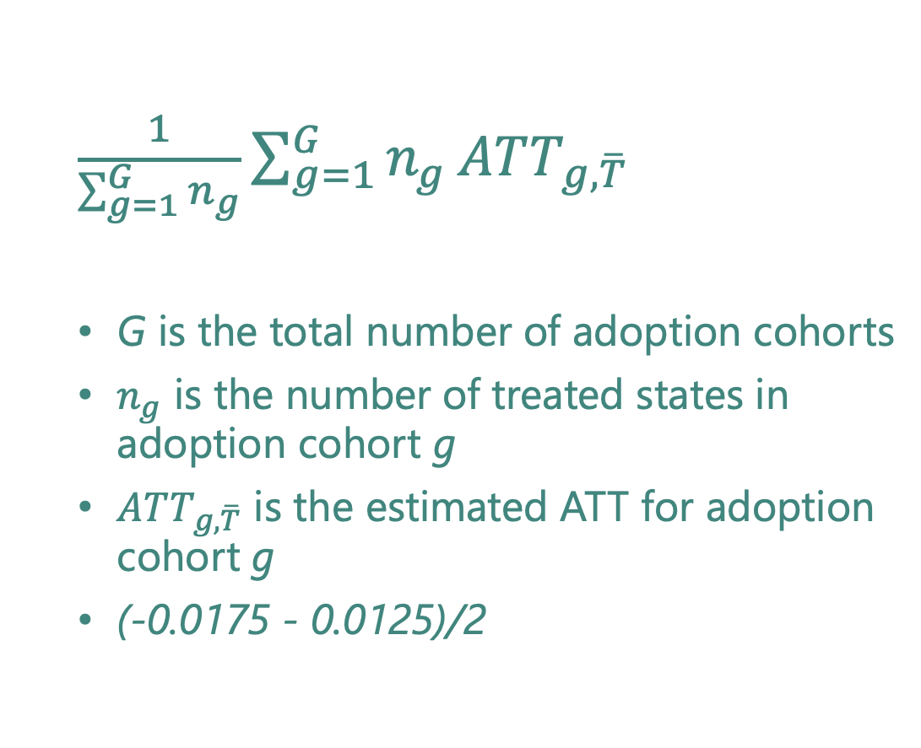
Summary measure A: Weighted average across adoption cohorts
$\frac{1}{\sum_{g=1}^{G}{n_{g}}}\sum_{g=1}^{G}{n_{g}}ATT_{g,\overline{T}}$
G is the total number of adoption cohorts
$n_{g}$ is the number of treated states in adoption cohort g
$ATT_{g, \overline{T}}$ is the estimated ATT for adoption cohort g
(-0.0175 - 0.0125)/2
ATT₄ = -0.0125
ATT₂ = -0.0175
Notes:
We are going to focus on 3 different summary measures that we think are the most intuitive ways to summarize the individual ATTs into one parameter.
First, summary measure A: this is a weighted average of ATTs across adoption cohorts, where the weights are the number of treated states in each adoption cohort.
Note that the ATTs for each adoption cohort are themselves an average of the effects over the entire post-intervention period.
In this case, we just have one treated unit at time 2 and one treated unit at time 4, so it’s just a simple average between the two ATTs.
$ATT_{g, \overline{T}}=\frac{1}{T}\sum_{t:t_{g}+t<T}{ATT_{g,t}}$ is the simple average of the treatment effects across all post-intervention time points for which effects exist for adoption cohort g (i.e., $t_{g}+t<T$ where $t_{g}$is the initial time of policy adoption for cohort g, t is the number of periods after initial policy adoption, and T is the maximum number of time points in the study across adoption cohorts).

Slide 16
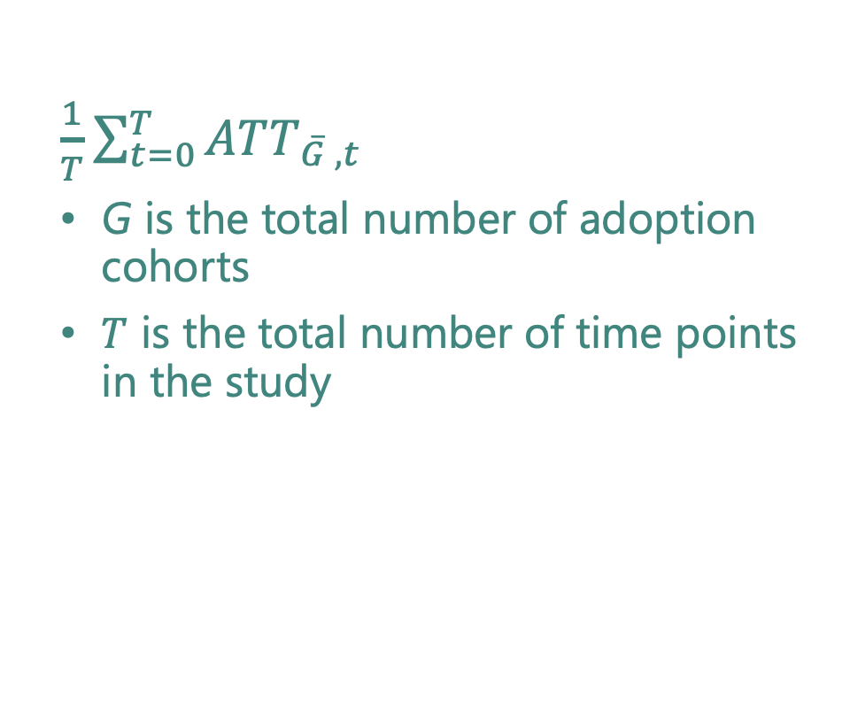
Summary measure B: Weighted average for time since adoption
$\frac{1}{T}\sum_{t=0}^{T}{ATT_{\overline{G} ,t}}$
G is the total number of adoption cohorts
$T$ is the total number of time points in the study
Notes:
Summary measure B is the average across post-intervention time points
So for example, here I’ve aligned the treated time points as we would in an event study design. Then I’ve highlighted the first post-intervention timepoint. We would calculate a simple average of the two ATTs for these two treated time points.
$ATT_{\overline{G},t}=\frac{1}{\sum_{g:t_{g}+t<T}{n_{g}}}\sum_{g:t_{g}+t<T}{n_{g}ATT_{g,t}}$ is the average ATT across adoption cohorts for t periods since the policy was adopted.

Slide 17
Summary measure B: Weighted average for time since adoption
$\frac{1}{T}\sum_{t=0}^{T}{ATT_{\overline{G} ,t}}$
G is the total number of adoption cohorts
$T$ is the total number of time points in the study
Notes:
Next, we would calculate a simple average of the ATTs at the next time point.

Slide 18
Summary measure B: Weighted average for time since adoption
$\frac{1}{T}\sum_{t=0}^{T}{ATT_{\overline{G} ,t}}$
G is the total number of adoption cohorts
$T$ is the total number of time points in the study
Notes:
For time points after that, the unit that was treated at time point 4 doesn’t have any additional post-intervention time points. So, our estimate of the “overall” ATT for time points after time 1 are just the individual ATTs for the adoption cohort that was treated in the original time point 2.
Then we take the simple average of all of these ATTs to get our overall summary measure.

Slide 19
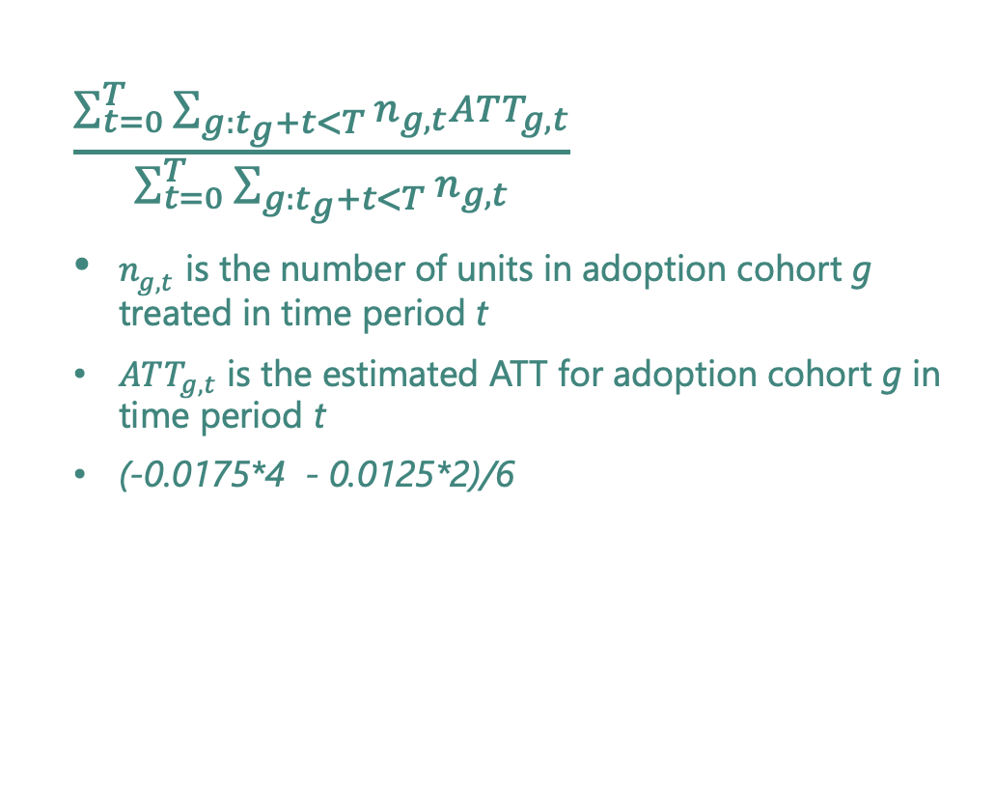
Summary measure C: Weighted average for time since adoption
$\frac{\sum_{t=0}^{T}{\sum_{g:t_{g}+t<T}{n_{g, t}ATT_{g,t}}}}{\sum_{t=0}^{T}{\sum_{g:t_{g}+t<T}{n_{g, t}}}}$
$n_{g,t}$ is the number of units in adoption cohort g treated in time period t
$ATT_{g,t}$ is the estimated ATT for adoption cohort g in time period t
(-0.0175*4 - 0.0125*2)/6
ATT₄ = -0.0125
ATT₂ = -0.0175
Notes:
Finally, our last summary measure is Summary measure C.
This combines the last two, and instead of taking a simple average of either across adoption cohorts or across time, we use a time- and unit-weighted approach.
So we take each individual ATT and multiply it by the number of units in each adoption cohort that were treated in each time point.
We sum all of these, and then divide by the total number of treated unit-time points. This is kind of similar to a rate in which the denominator is total person-time
In this case, we only have one treated unit in each adoption cohort. So we have 4 post treatment time points for the adoption cohort treated at time point 2, and 2 post treatment time points for adoption cohort treated at time point 4. We divide this by 6 because we have a total of 6 total treated unit-time periods.

Slide 20
Cohort ATT¹
The main goal of the cohort ATT estimator is for event study designs in which dynamic effects are of interest
Each cohort ATT is estimated using an interacted TWFE regression
Combines estimates for ATTs for each adoption cohort
Allows different aggregation schemes
No option for summary measure B is available in current software
¹Sun L, Abraham S. Estimating dynamic treatment effects in event studies with heterogeneous treatment effects. J Econometrics. 2021;225:175–199.
Notes:
The main goal of the cohort ATT estimator is for event study designs in which dynamic effects are of interest
Each cohort ATT is estimated using an interacted TWFE regression, in which a linear model is used that includes unit fixed effects, time fixed effects, and the interaction between indicators for belonging to a treatment cohort at time t and the indicator for unit i being k periods away from initial treatment.
This also allows you to estimate ATTs for each adoption cohort, and allows different aggregation schemes, like the group-time ATT
In current software, only summary measures A and C are available (so we won’t show results for summary measure B for this estimator)

Slide 21
Target trial¹
This approach uses an event study design, to emulate a target trial of some policy implementation
An ATT for each posttreatment period is calculated by:
(Mean(Treated_post) – Mean(Control_post)) – (Mean(Treated_t-1) – Mean(Control_t-1))
Inference in the target trial approach is calculated using the jackknife.
We aggregated the estimates according to the summary measures A, B, and C
¹Ben-Michael E, Feller A, Stuart EA. A trial emulation approach for policy evaluations with group-level longitudinal data. Epidemiology (Cambridge, Mass). 2021;32:533–540.
Notes:
Similar to the group-time ATT and cohort ATT approaches, this method requires identifying the comparison of interest for each adoption cohort, and then aggregating.
In this case, the comparison of interest refers to the trial we are emulating for each cohort as they adopt the policy. This approach resembles the event study design, in which the timing of policy implementation is aligned for each unit, so that time as represented in the regression model is relative to the policy adoption time (often called “time zero”).
A DID estimate for each posttreatment period is calculated by taking the average of the outcome in the treated units in the postperiod time, subtracting the average of the outcome of the control units at the same time, and subtracting the difference between the treated and control units observed in the time period immediately preceding the policy adoption.
Under the parallel trends assumption, these latter differences should represent the difference between the treated and control units at each time posttreatment in the absence of the policy. Inference in the target trial approach is calculated using the jackknife.
We aggregated the estimates for summary measures A, B, and C.

Slide 22
Analysis of approaches to analyze staggered differences-in-differences
Evaluate the performance of TWFE and alternate approaches under different simulated scenarios
Constant treatment effects
Heterogeneous treatment effects
Dynamic treatment effects
Apply methods to an empirical example to assess how much methods differ in practice
Notes:
To evaluate the performance of these TWFE estimators and some alternatives under different simulated scenarios, Corinne and I conducted a simulation study and applied it to an empirical example.
We focused on three different types of parameters: constant treatment effects, in which the causal effect of the intervention is the same for all units and doesn’t change depending on how long a unit has been treated, heterogeneous treatment effects, in which early adopters and late adopters of an intervention have different size treatment effects, but the treatment effect doesn’t change over time, and dynamic treatment effects, in which all units have the same treatment, but the size of the treatment effect changes depending on the time since adoption.
We also then applied each of these methods to an applied example to illustrate how different estimates could be in practice.

Slide 23
Empirical example
As part of the ACA, states expanded Medicaid to non-elderly adults with incomes <138% FPL
24 states expanded in January 2014
5 states between February 2014 and December 2015
2 states in 2016
7 states between 2017 and 2021
We used restricted birth records from NCHS from 2011 to 2016 for state-level prevalences of preterm birth
Motivated by previous studies that have used TWFE^{1,2}
¹Brown CC, Moore JE, Felix HC, Stewart MK, Mac Bird T, Lowery CL, Tilford JM. Association of state Medicaid expansion status with low birth weight and preterm birth. Jama. 2019 Apr 23;321(16):1598-609.
²Clapp MA, James KE, Kaimal AJ, Sommers BD, Daw JR. Association of Medicaid expansion with coverage and access to care for pregnant women. Obstetrics & Gynecology. 2019 Nov 1;134(5):1066-74.
Notes:
For our empirical example, we estimated the effect of adopting the Medicaid expansion on the prevalence of preterm birth.
The Medicaid expansion was part of the Affordable Care Act in which Medicaid eligibility was increased for non-elderly adults to 138% of the FPL
Different states adopted the expansion at different times
Previous studies have looked at the effects of the ACA’s Medicaid expansion on risk of preterm birth, and have used TWFEs to estimate the effects
We use these analyses as a jumping off point, and use the national restricted birth records from the National Center for Health Statistics from 2011-2016

Slide 24
Simulation
Parameterized the simulations using actual Medicaid expansion timing and preterm birth prevalences across state-months from 2011-2016
Simulated 3 types of effects
Constant treatment effect of -0.02
Heterogeneous treatment effects
-0.01 among early adopters
-0.02 among late adopters
Dynamic treatment effect of
-0.01 in the first year
-0.015 in the second year
-0.02 for all subsequent years
Notes:
We also parameterized our simulation to emulate the setup of the Medicaid expansion and preterm birth question
We simulated three types of effects:
Constant treatment effects, where the effect of expanding Medicaid was a decrease in risk of preterm birth of 0.02 for all units and time periods
Heterogenous treatment effects, in which states that expanded Medicaid before June 2014 had a decrease in risk of 0.01 and states that expanded after that had a decrease of 0.02
This is plausible if states that adopted earlier already had more generous or comprehensive Medicaid policies, or better support for low-income non-elderly adults before, and so the expansion of Medicaid was less impactful
Finally, we also examined the effects on dynamic treatment effects, in which the treatment effect was dependent on the time since adoption.
We simulated the effect to increase over the years since adoption, to mimic a “ramping up” of the intervention effect, which we thought was plausible in the example of Medicaid expansion because there may have been slow uptake of expanded eligibility in the first two years.

Slide 25
Estimators
Two-way fixed effects (TWFE)
Group-time average treatment effect on the treated (Group-time ATT)¹
Cohort average treatment effects on the treated (Cohort ATT)²
Target trial approach³
¹Callaway B, Sant’Anna PH. Difference-in-differences with multiple time periods. Journal of Econometrics. 2021 Dec 1;225(2):200-30.
²Sun L, Abraham S. Estimating dynamic treatment effects in event studies with heterogeneous treatment effects. Journal of Econometrics. 2021 Dec 1;225(2):175-99.
³Ben-Michael E, Feller A, Stuart EA. A trial emulation approach for policy evaluations with group-level longitudinal data. Epidemiology (Cambridge, Mass.). 2021 Jul;32(4):533.
Notes:
We compared several different estimators, all of which are aiming to estimate the ATT
The TWFE approach
Group-time average treatment effect on the treated
Cohort average treated effect on the treated
Target trial approach
These last 3 are all methods that estimate the ATT for each treated unit, and then use various methods of summarization to get an overall estimate of effect.

Slide 26
Measures
Confidence interval coverage
Bias
MSE
Statistical power
Notes:
We ran the simulation 1,000 times and calculated the following measures of performance
95% confidence interval coverage
Bias
MSE
Statistical power

Slide 27
Alternate scenarios
Equal distribution of implementation times
Extended follow-up time
Limit to ever-treated units
Notes:
We also conducted a few alternate versions of the simulation
Since the majority of states adopted Medicaid in January 2014, we wanted to see how the results changed if the adoption times were more balanced. So we picked 4 adoption times equally spaced throughout the follow-up period and randomly assigned treated states to one of those adoption times.
Since many of the analyses of Medicaid expansion occurred soon after adoption, we wanted to see how results would change as more time passes and we have additional follow-up time for all states.
We also conducted analyses that limit to ever-treated units. This may be necessary for analyses in which all units are eventually treated, or if the places that are treated are so different from the untreated units that an investigator thinks there may be positivity problems when using the untreated as controls.

Slide 28
Results

Slide 29
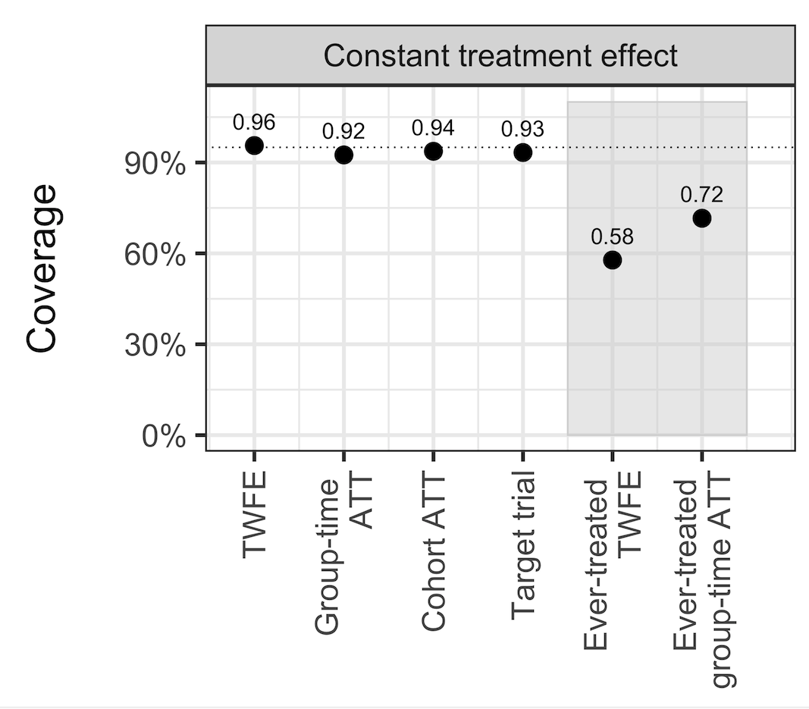
Constant treatment effects
Notes:
So here are the simulation results for the constant treatment effects
I’m only showing the coverage results because they best show the relative performance of the estimators, but I have the other results in extra slides for anyone who is curious.
So the y-axis shows the 95% confidence interval coverage over the 1,000 simulations, and the x-axis shows each of the estimators
On the left is the two-way fixed effect estimator, next is the group-time ATT, then the cohort ATT, and the target trial appraoches.
The gray rectangle represents the estimators that limit to the ever-treated group, and use the not-yet-treated as controls.
We see for the constant treatment effects, all the estimators perform well, except when limiting to ever-treated groups. Then both the TWFE and group-time ATT have worse coverage, and the drop is particularly bad for the TWFE.

Slide 30
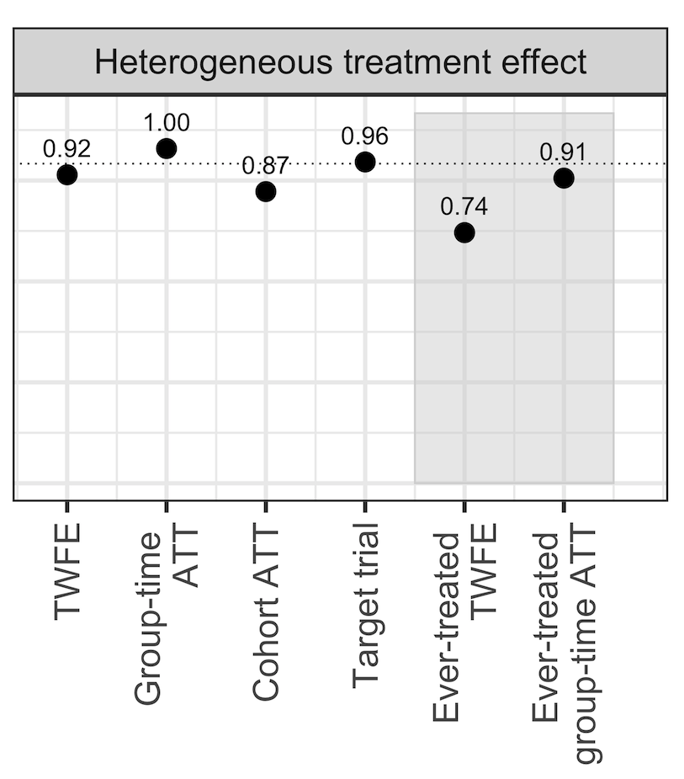
Heterogeneous treatment effects
Notes:
Here are the results for heterogeneous treatment effects. Again this scenario is when the early adopters had a smaller treatment effect compared to late adopters.
The results here are similar to the constant treatment effects. While we were expecting the performance of the TWFE to be worse, it still does well, and that is likely due to the fact that the majority of treated units were all early adopters, and only a few states were late adopters. This means that the average effect is more similar to the effect for early adopters.
Also worth noting the the cohort ATT drops time periods in which only one unit is treated, which in this case biased the estimation of the HTE.
Again, limiting to ever-treated groups reduced the coverage, especially for the TWFE estimator.

Slide 31
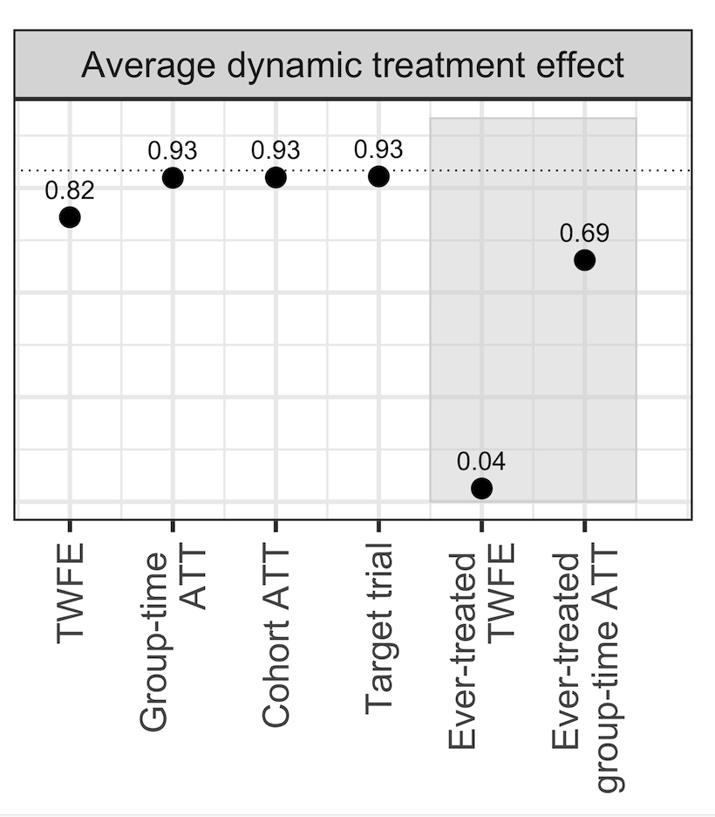
Average dynamic treatment effects
Notes:
Next, we have the results for the average dynamic effects. This is the scenario in which the treatment effect varies over time, but we are analyzing the effects as though they do not.
In this case, the TWFE performs much worse than the other estimators, and especially in the ever-treated situation.

Slide 32
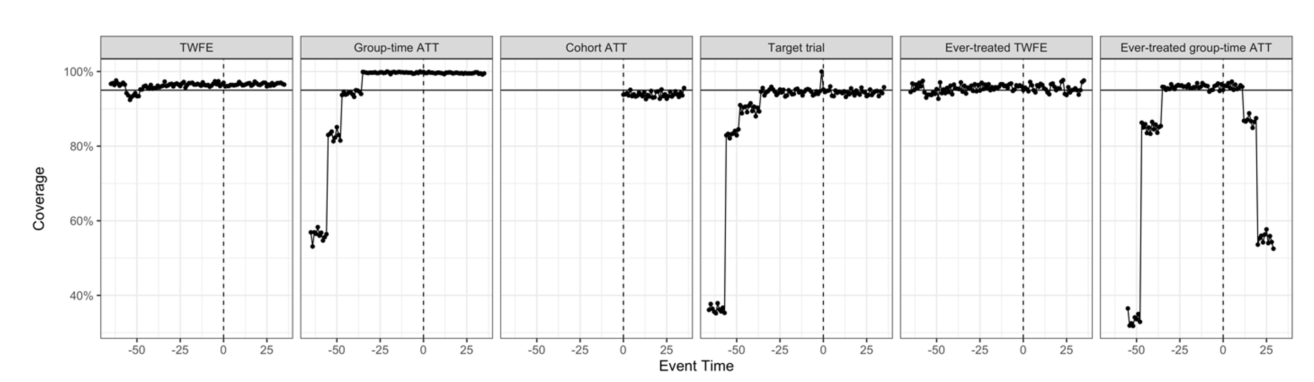
Dynamic treatment effects
Notes:
Then we looked at the dynamic effects, which analyze the effects at each time point since the intervention.
So, we have lead times, that are the times prior to the intervention, where we would expect the treatment effects to be 0.
Then we have the post-intervention times. In this scenario, the treatment effects increased over the two-years after the intervention, and then stayed constant after that.
Here, the estimators all performed well, except near the beginning and ends of the follow-up, when there were few control units. You can see this especially with the ever-treated group-time ATT, which has stepwise declines in coverage as fewer units are included in the analysis.

Slide 33
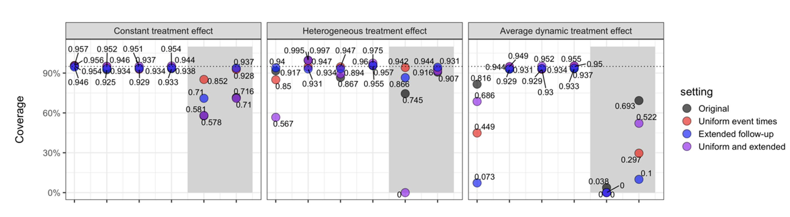
Alternate specifications
Notes:
Now I will show the results of the simulations that included alternate specifications, and compare them to the results we just walked through.
So on the left we have the constant treatment effects, then the results for the heterogeneous treatment effects in the center, and the average of the dynamic effects on the right.
The black circles represent the results you’ve already seen.
The red circles represent the situation in which we assigned states to 4 expansion times uniformly during the follow-up. Again, we did this to assess whether having a more even distribution of treatment times would affect how the estimators performed.
The blue circles are the results when we extended the follow-up by another 72 months. Again, we did this because the TWFE can be sensitive the length of the panel, and because it is likely studies on Medicaid expansion will continue to be done with more and more follow-up time.
The purple circles represent the results where there was uniform expansion times and extended follow-up.
We see that all the estimators in all scenarios performed well when the treatment effects were constant, except when limiting to the ever-treated units.
For heterogeneous treatment effects, we see that most of the estimators continued to perform well, but TWFE had worse coverage, especially when there was uniform expansion timing and extended follow-up time.
Finally, when we estimated average dynamic effects, TWFE performed poorly under each of the four scenarios, and especially badly when limiting to ever-treated units.

Slide 34
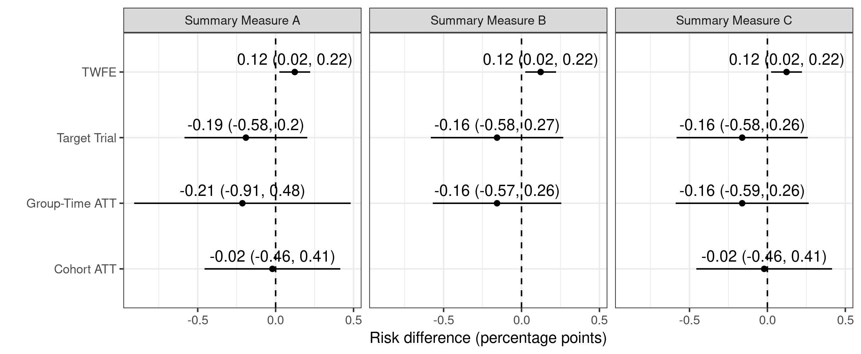
Medicaid expansion and risk of preterm birth
Notes:
So next we applied each of the estimators to our example of the effects of Medicaid expansion on the risk of preterm birth, and showed how the findings varied based on the different summary measures.
On the y-axis we have each of the estimators, and on the x-axis we have the percent risk difference in preterm birth associated with adopting the Medicaid expansion.
We’ve then separated the effects for Summary measure A, B, and C.
The target trial, group-time ATT and the cohort ATT estimated negative effects, with wide confidence bounds.
The TWFE estimator, in contrast, estimates an increase in preterm birth with narrow confidence intervals that do not cross the null.

Slide 35
Takeaways for your research
TWFE are unbiased estimators of the ATT if treatment effects are constant and relationships are linear
But we can never know this for sure
Variance is lower
Affected by the timing of treatments relative to length of study
Group-time ATT and Target trial approaches are most flexible
Cohort ATT approach drops time periods in which only one unit is treated, but otherwise performs similarly well
Important to think through your parameter of interest, especially how you want to summarize the ATTs
Notes:
In conclusion, our results are consistent with previous work that showed TWFE can be unbiased estimators of the ATT if the treatment effects are constant and relationships are linear.
But we can never know this for sure, and these are unlikely to be true in most contexts.
The TWFE estimator has a much lower variance than the other estimators. Thus, depending on the specifics of the data, the question of interest, and the bias-variance tradeoff preferences of the investigator, the two-way fixed effects approach may still be preferred.
One underappreciated aspect of two-way fixed effects estimators is how they are affected by the timing of policy changes in reference to the length of the panel, such that simply extending follow-up time in the pre- or post- period can change the estimate. Because the earliest treated units are used as controls for later treated units by the two-way fixed effects estimator, this can actually reverse the sign of the two-way fixed effects estimate if the earliest treated units undergo large or growing effects of the policy change. This is also important for when treatment effects are heterogeneous, as changing the length of follow-up time changes the weights used to summarize the ATTs. If the investigator does not account for this, the two-way fixed effects estimate can give a misleading answer. In the simulation study, we observed the lowest coverage for the two-way fixed effects estimator when the follow-up time was extended.
We also found the group-time ATT estimator was the most flexible and performed well under all scenarios, but the cohort ATT estimator also performed well, even though it drops time periods in which only one unit is treated.
When implementing these methods, it’s important to think through your parameter of interest, especially how you want to summarize the ATTs. Corinne will talk more about this in the next section, but this is an underappreciated but key point to these methods

Slide 36
Takeaways for your research
Limiting to ever treated units can increase bias when there are few treated units
Time since intervention approach is more robust regardless of method
Care must be taken when interpreting results at the end or beginning of follow-up when there are few treated and/or control units
Notes:
We also found that limiting to ever treated units can increase bias when the number of treated units is low
The time since intervention approach is more robust for all methods, although care should be taken when interpreting results at the beginning or end of follow-up

Slide 37
Acknowledgements & Funding
Corinne Riddell, UC Berkeley
NIH K99ES033274 (PI: Goin)

Slide 38
Thank you!
dg3369@cumc.columbia.edu
Notes:
Thanks so much!

Slide 39
Extra slides

Slide 40
References and additional resources
Goin DE, Riddell CA. Comparing two-way fixed effects and new estimators for difference-in-differences: a simulation study and empirical example. Epidemiology. 2023 Jul 1;34(4):535-43.
Riddell CA, Goin DE. Guide for comparing estimators of policy change effects on health. Epidemiology. 2023 May 1;34(3):e21-2.
Goodman-Bacon A. Difference-in-differences with variation in treatment timing. Journal of econometrics. 2021 Dec 1;225(2):254-77.
Callaway B, Sant’Anna PH. Difference-in-differences with multiple time periods. Journal of econometrics. 2021 Dec 1;225(2):200-30.
Sun L, Abraham S. Estimating dynamic treatment effects in event studies with heterogeneous treatment effects. J Econometrics. 2021;225:175–199.
Ben-Michael E, Feller A, Stuart EA. A trial emulation approach for policy evaluations with group-level longitudinal data. Epidemiology (Cambridge, Mass). 2021;32:533–540.
Roth J, Sant’Anna PH, Bilinski A, Poe J. What’s trending in difference-in-differences? A synthesis of the recent econometrics literature. Journal of Econometrics. 2023 Aug 1;235(2):2218-44.
Baker A, Callaway B, Cunningham S, Goodman-Bacon A, Sant'Anna PH. Difference-in-Differences Designs: A Practitioner's Guide. arXiv preprint arXiv:2503.13323. 2025 Mar 17.
Wang G, Hamad R, White JS. Advances in difference-in-differences methods for policy evaluation research. Epidemiology. 2024 Sep 1;35(5):628-37.

